Slide 1
EUROPEAN EXHIBITOR PR PACK

Slide 2
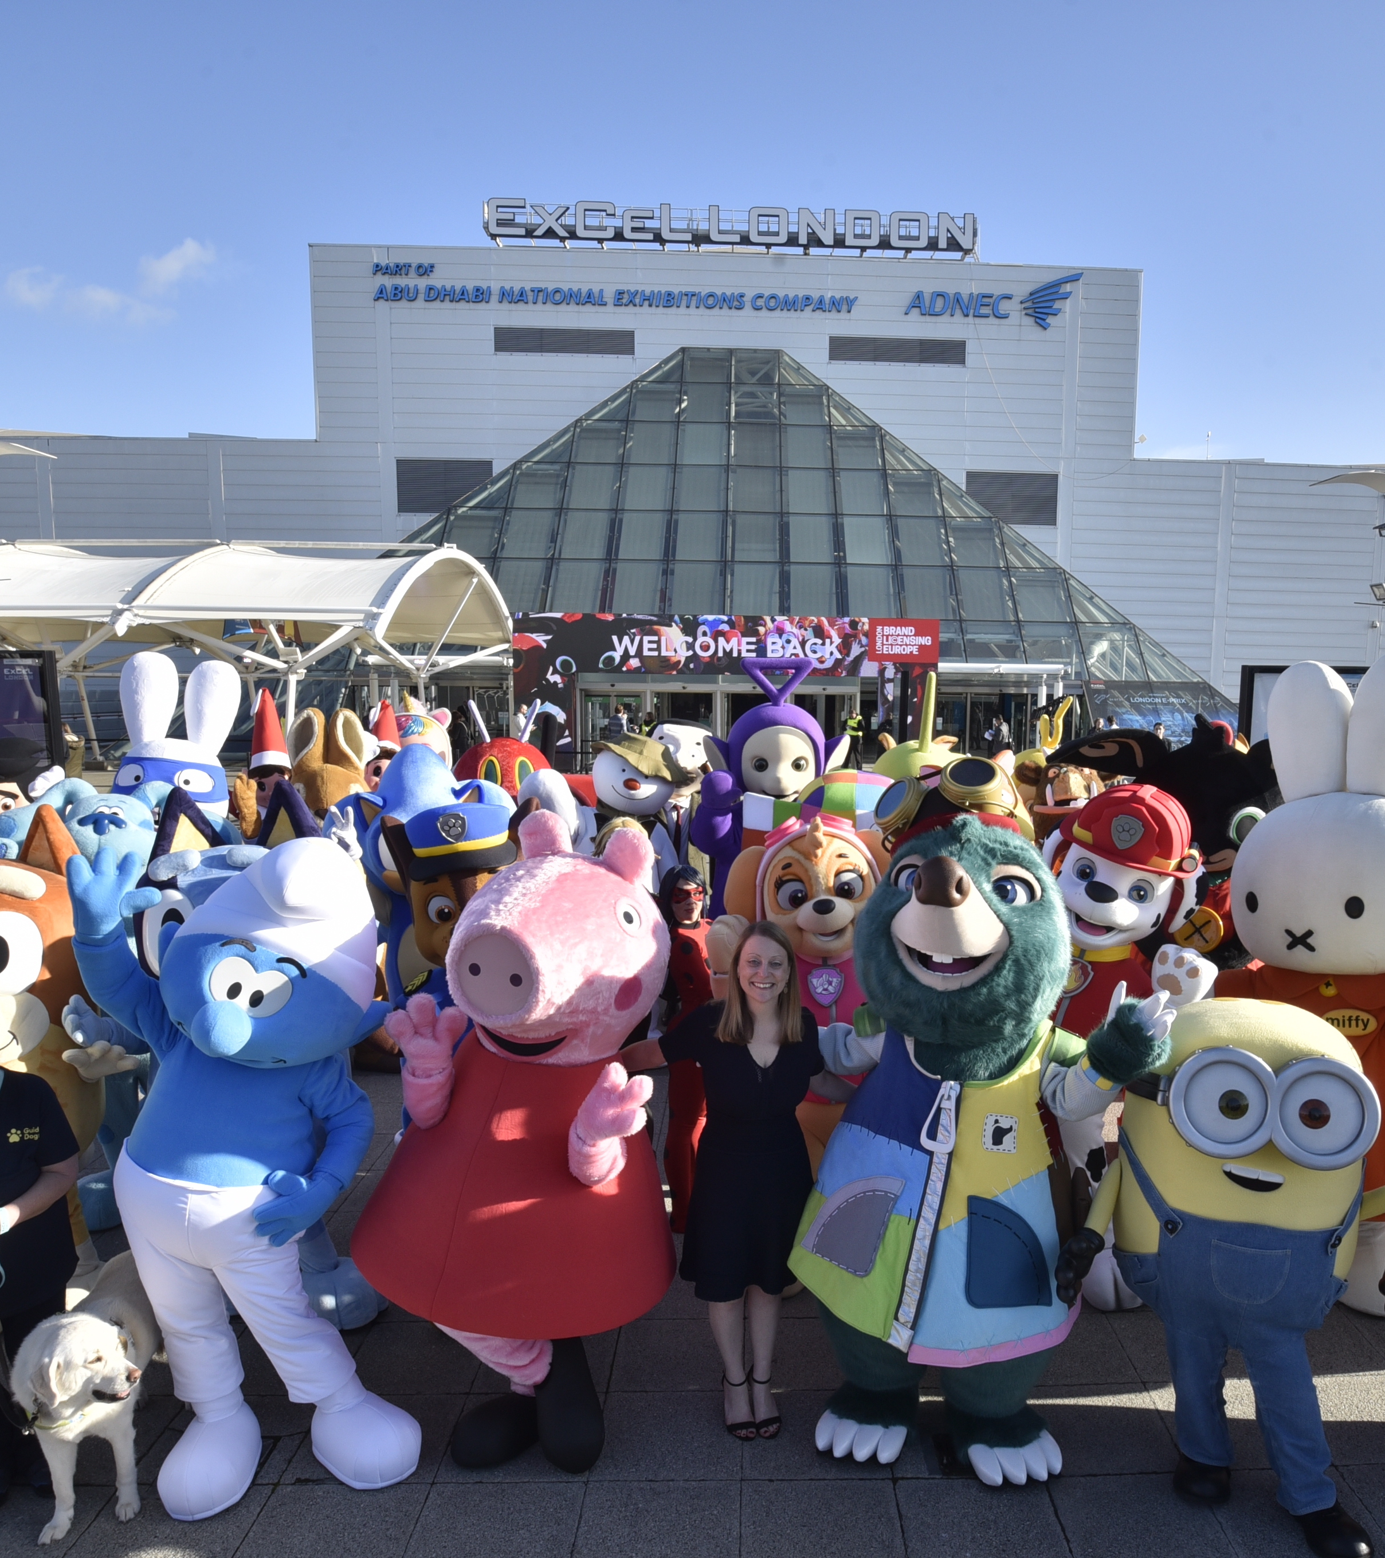
LET'S GET YOU SOME FREE PR
Journalists from influential publications cover Brand Licensing Europe each year, including from all over Europe, the UK and North America.
As a European exhibitor, your stories are important, and we can get you free media coverage before and during BLE 2024.
All you need to do is tell us all about your business and the brands you work with, and we will work with you (for free) to make telling your story as easy as possible.
THIS IS A FREE OPPORTUNITY.
BIG TOP IS BLE's OFFICIAL PR AGENCY.

Slide 3
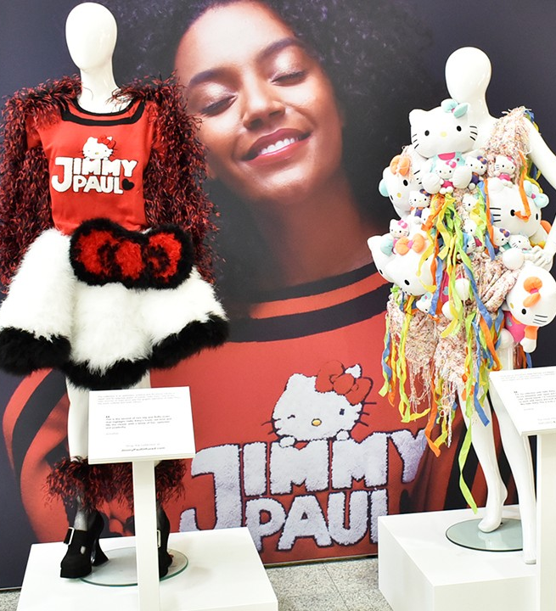
IT’S QUICK AND EASY
The plan is work with you on thought leadership articles, interviews and Q&As to get you media coverage in:
Licensing media in Europe, UK and North America, including License Global
Business media based on the categories you work with – e.g. gifts, toys, homeware, video games
Potentially, national print and broadcast media
You will be able to approve all copy and can we may even be able to help you craft comments and quotes.

Slide 4
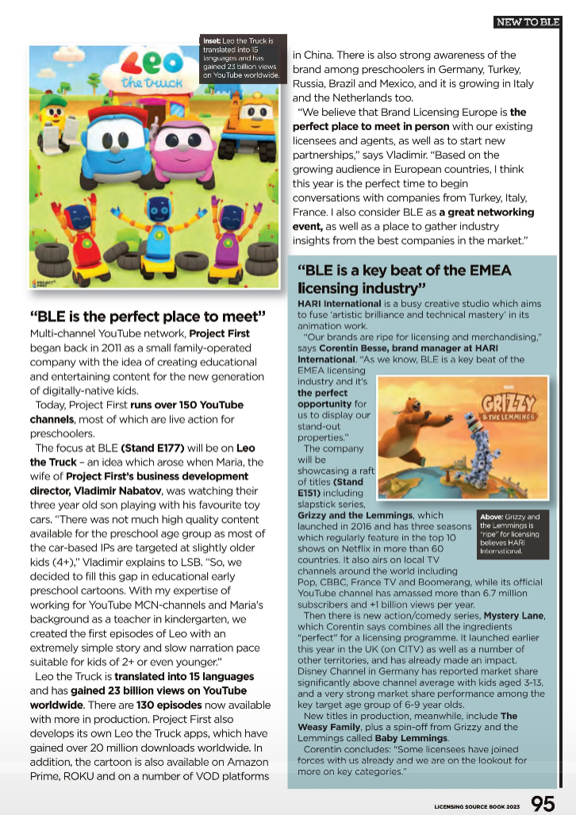
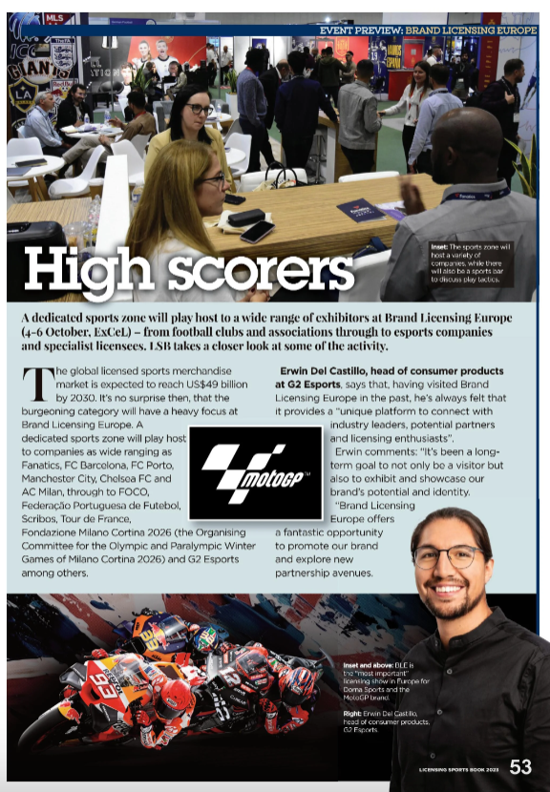
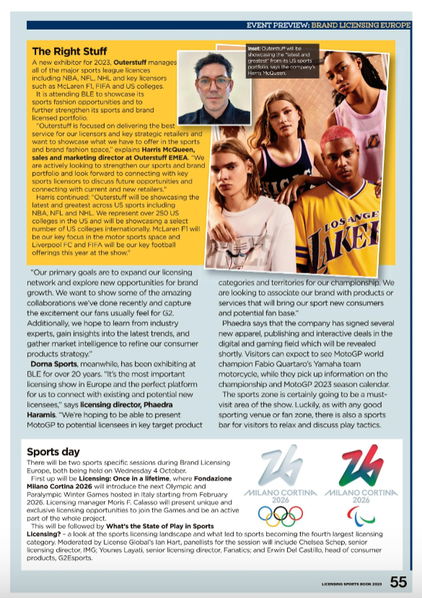
SEE YOUR BRANDS IN THE MEDIA FOR FREE

Slide 5
ANSWER THESE QUESTIONS TO GET STARTED
We hope you want to get involved – we’d love to help. And remember, this is completely free for BLE exhibitors.
Next step: answer these questions and email them to Charlie Le Rougetel at charlie@bigtop-pr.co.uk
Would you like to take part in media interviews before and at BLE? Yes/No
Do you want to write/contribute to thought leadership articles before BLE? Yes/No
Do you want to meet journalists at the show? Yes/No
Tell me about your business and the brands you work with.
What country are you organisation based in?
What are the biggest challenges and opportunities facing the licensing industry in your territory?
Which licensing categories do you work in?
Why are you exhibiting at BLE and what will you have to show licensees and retailers?
Are you launching new brands, products and announcing any news at BLE?
If so, what is it, who is it for why should licensees and retailers be excited by it?
Is there anything else you’d like to tell us about yourself?

Slide 6
BIGTOP
CHARLIE@BIGTOP-PR.CO.UK
07736 330676

